Slide 1


Data Analytics and Algorithms Portfolio
Name - Mitul Srivastava
Module – Data analytics and algorithms
Lecturer – Dr Greg Doyle

Slide 2
Models covered in portfolio
Decision Tree
Random forest
Linear Regression
Logistic Regression
Support Vector Machines (SVM)
Naïve Bayesian
K-Nearest Neighbour
K-Means Clustering
Simple Neural Network
Convolutional Neural Network
Long Short Term Memory
Recurrent Neural Network
Transformers

Slide 3
Evaluation Metrics for Machine Learning
Classification
Regression
Others
Accuracy
Precision
Recall
F1 -Score
Confusion Matrix
Mean Squared Error
Mean Absolute Error
R2 Score in Regression
Silhoutte score in clustering
Test loss in Neural network
Loss Curves in Neural network

Slide 4
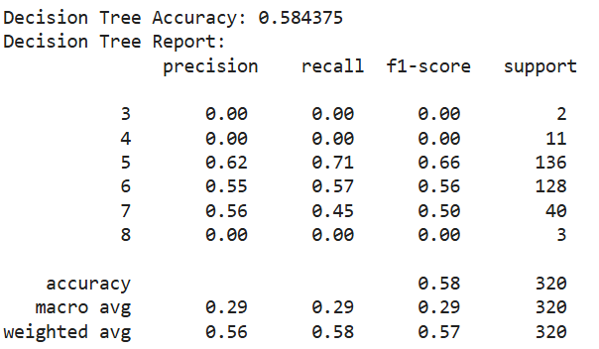
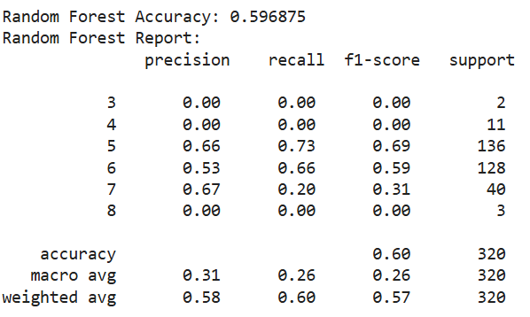
Decision Tree and Random Forest
Dataset : Red Wine dataset
AIM : To use and fine tune Decision Tree and Random Forest algorithm to predict wine quality.
Techniques used : 1. Train Test split
2. GridSearchCV
3. Feature Importance score
Metrics of Random Forest with depth 5 and random state 42 and 100 n_estimators
Metrics of Decision tree with depth 5 and random state 42

Slide 5
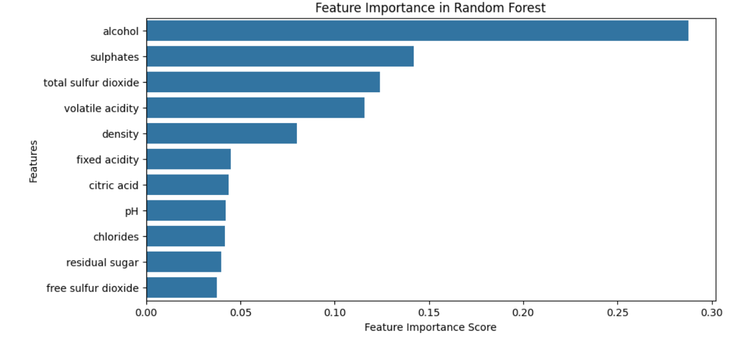
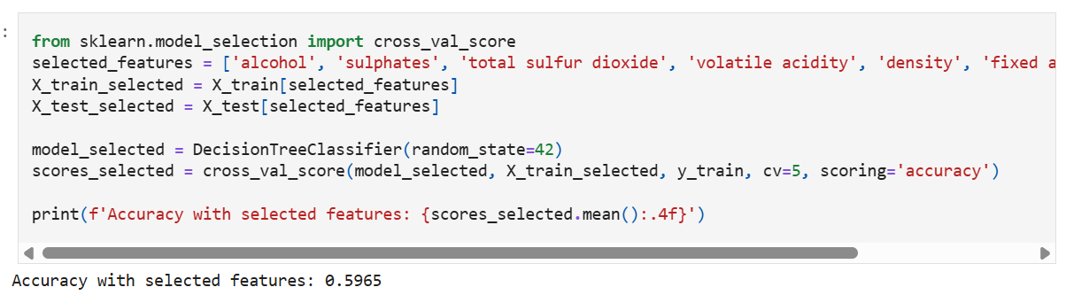
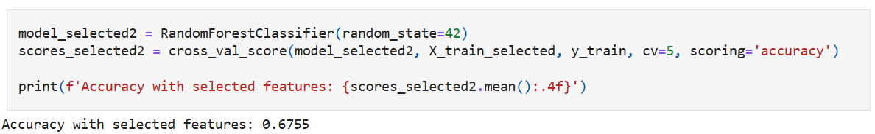
Training the Decision Tree model with selected features
Training the Random Forest model with selected features

Slide 6
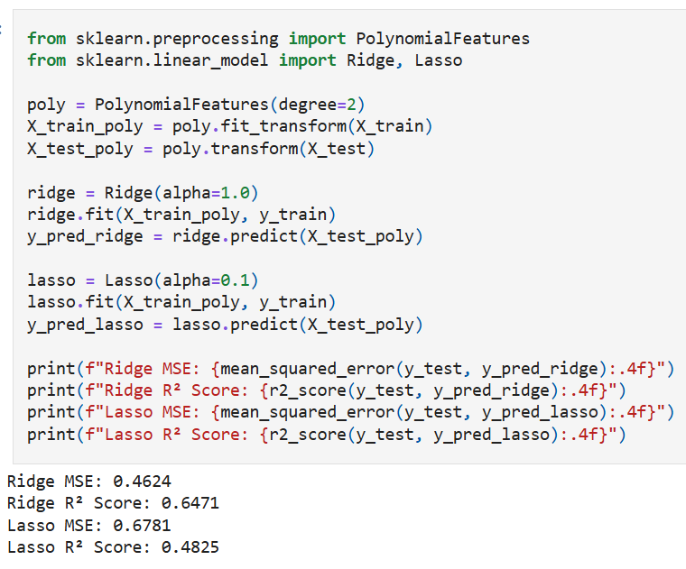
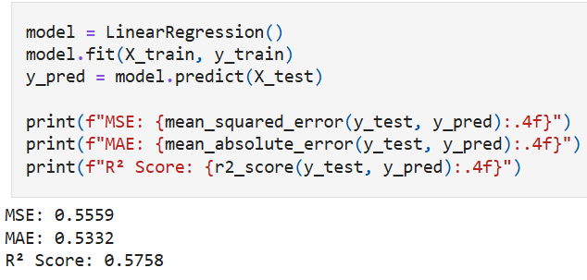
Linear Regression
DATASET : California Housing dataset
AIM : To train and fine tune Linear Regression model to predict the price of houses.
Techniques used – 1. Standard scaler
2. Train test split
3. Using Polynomial Features to capture non-linearity.
4. Trying Ridge and Lasso regression for better generalization.
Improved model metrics
Normal model metrics

Slide 7
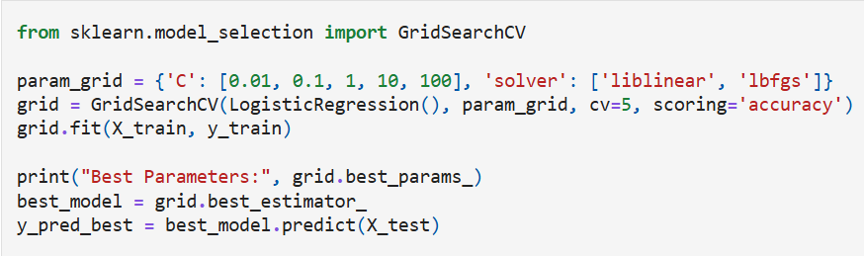
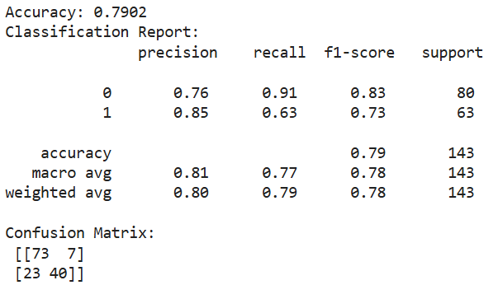
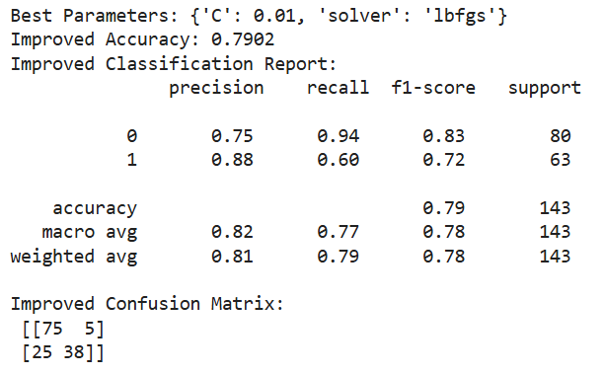
Logistic Regression
DATASET : Titanic dataset
AIM : To train and fine tune Logistic Regression model to predict if passenger survived or not.
Techniques used – 1. Standard scaler
2. Label encoder
3. GridsearchCV
GridsearchCV model metrics
Normal model metrics

Slide 8
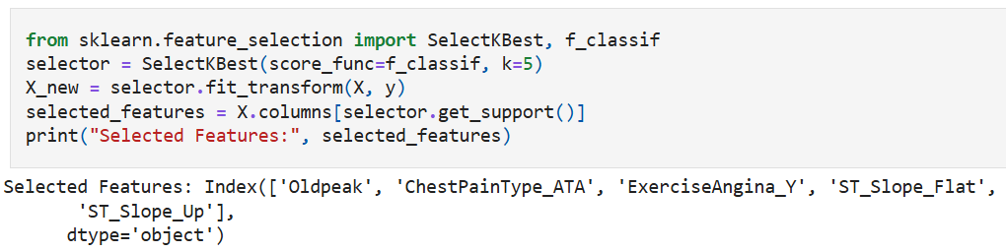
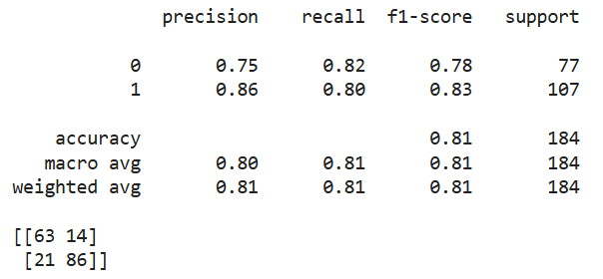
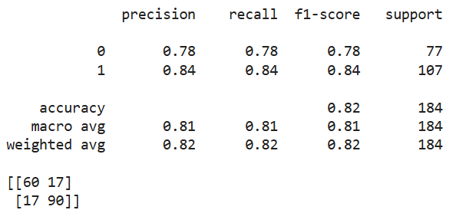
Support Vector Machines
DATASET : Heart disease dataset
AIM : To train and fine tune SVM model to predict if someone has a heart disease.
Techniques used – 1. Standard scaler
2. One hot encoding
3. Selectkbest
SVM model metrics with parameters (kernel = Sigmoid, C=10 and gamma = scale)
SVM model metrics with parameters (kernel = RBF, C=1 and gamma = scale)

Slide 9
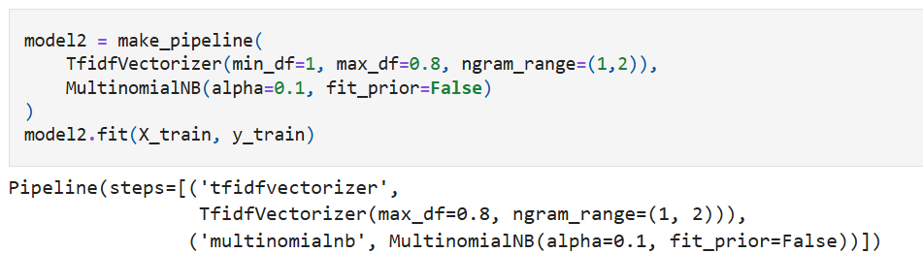
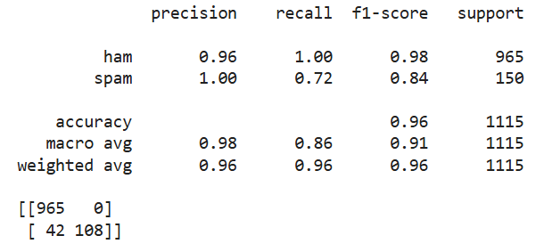
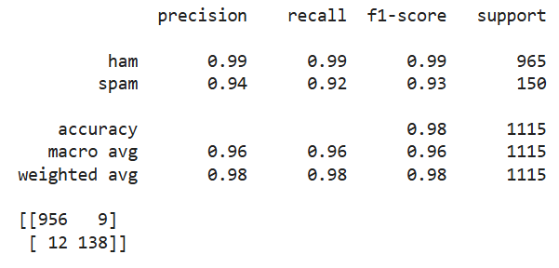
Naïve Bayes
DATASET : SMS Spam Collection Dataset
AIM : To predict if a message is "ham" or "spam" using Naive Bayes.
Techniques used – 1. Train test split
2. TfidVectorizer
3. MultinomialNB
Naïve Bayesian model with tuned hyperparameters for TfidVectorizer and MultinomialNB
Naïve Bayesian model with default TfidVectorizer and MultinomialNB

Slide 10
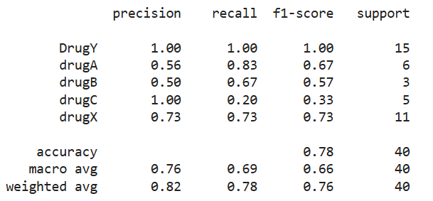
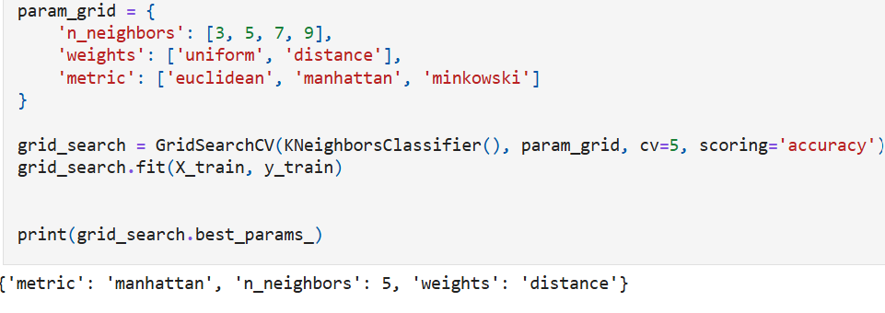
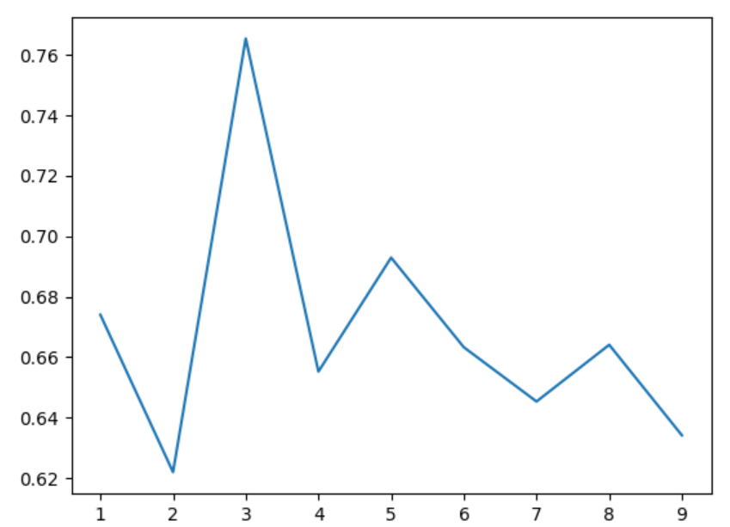
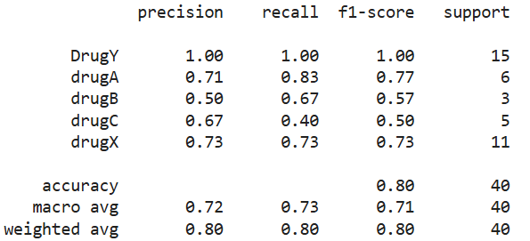
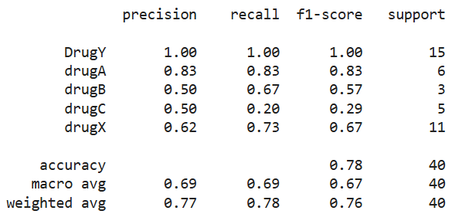
K- Nearest Neighbour
KNN results
GridSearchCV
DATASET : Drug Classification dataset
AIM : To use and fine tune KNN algorithm to classify drug type.
Techniques used – 1. Label Encoder
2. kNeighboursClassifier
3. GridsearchCV
KNeighboursClassifier
KNN results with n=3 and weights = distance
KNN GridsearchCV results

Slide 11
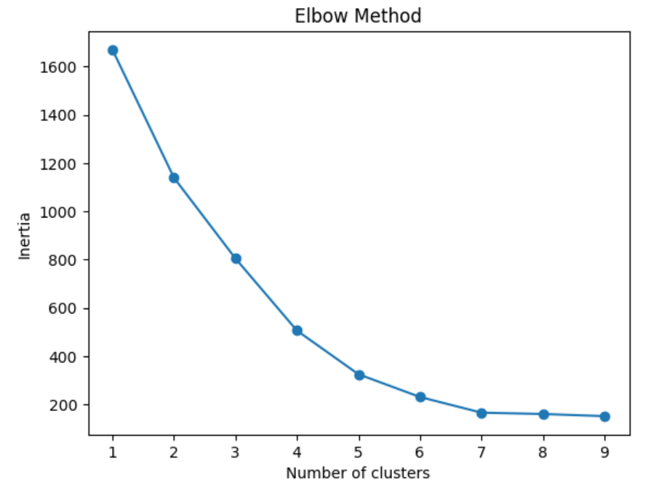
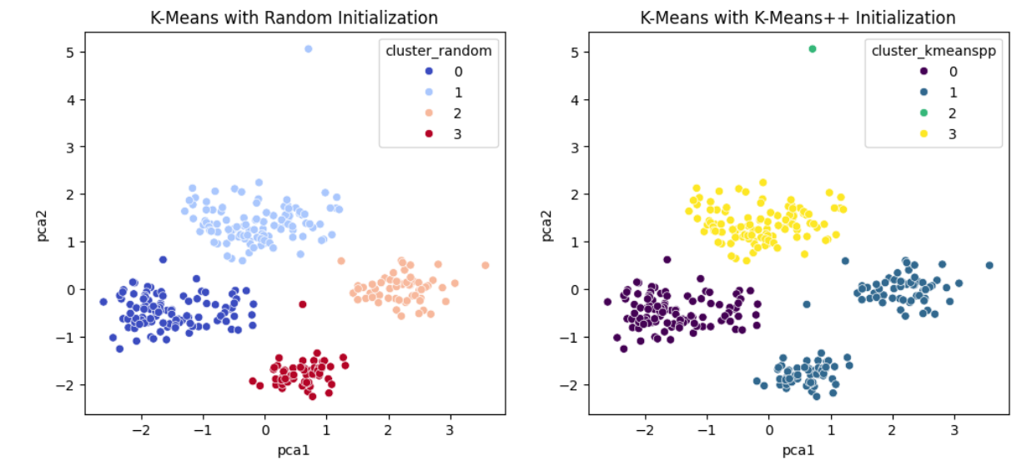
K- Means Clustering
DATASET : Penguins dataset
AIM : To use and fine tune K-means algorithm to create clusters for different species of penguins.
Techniques used – 1. Label Encoder
2. StandardScaler
3. Elbow method
4. Principal component analysis

Slide 12
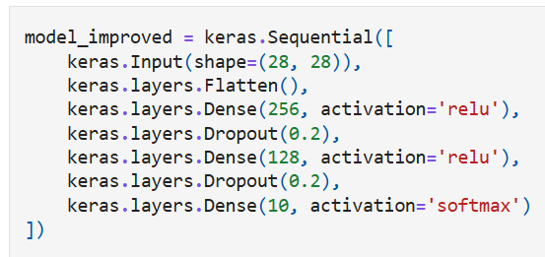
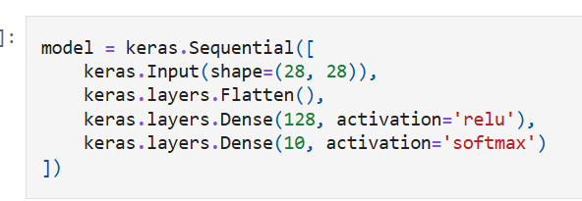
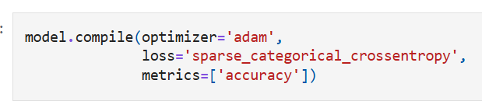
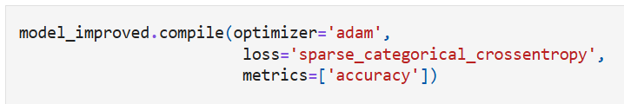
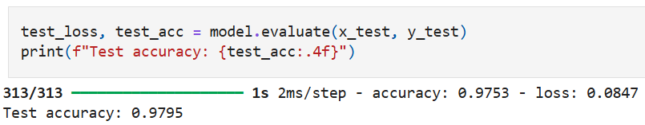
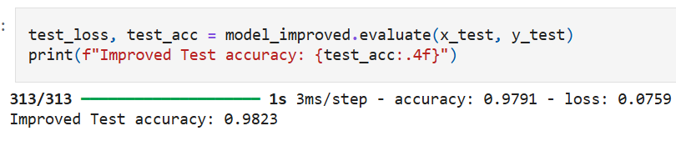
Simple Neural Network
DATASET : MNIST Handwritten Digits Dataset
AIM : To train and fine tune Simple Neural network to correctly identify digits.
Techniques used – 1. Train test split
2. Dropout
SNN with dropout and extra layer
Simple neural network

Slide 13
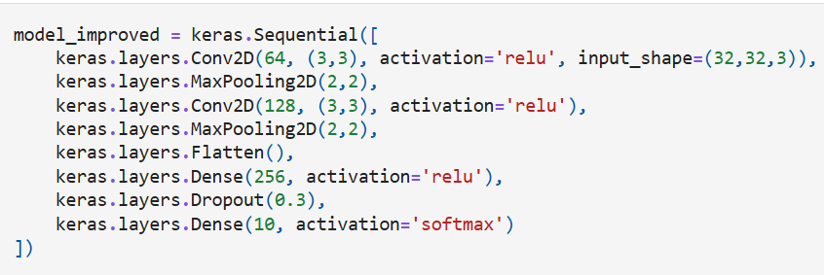
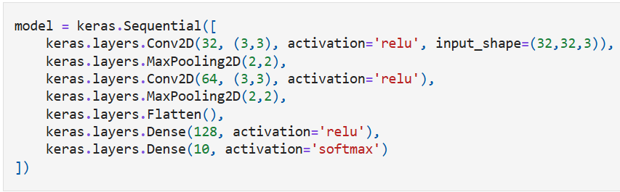
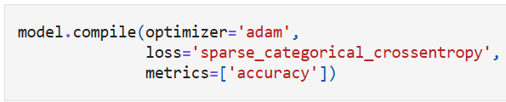
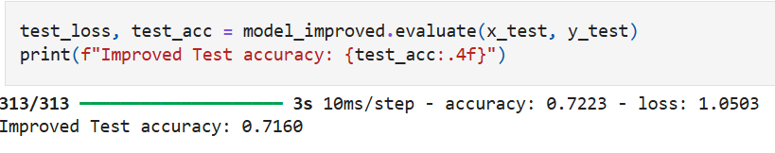
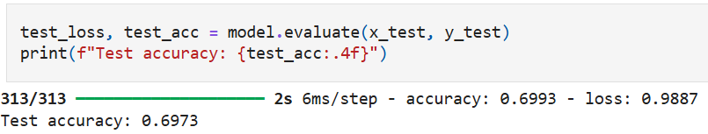
Convolutional Neural Network
DATASET : CIFAR-10 dataset
AIM : To train and fine tune Convolutional Neural network to correctly identify labels for images.
Techniques used – 1. MinMax scaling
2. Dropout
CNN with dropout and extra layer
Convolutional neural network

Slide 14
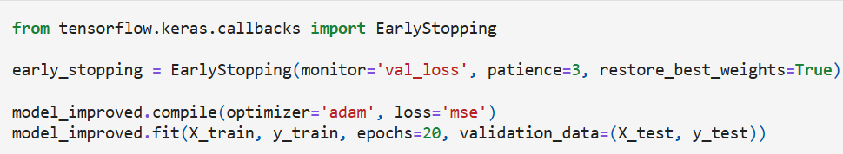
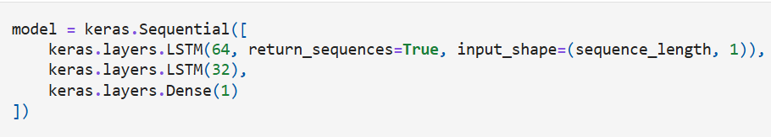
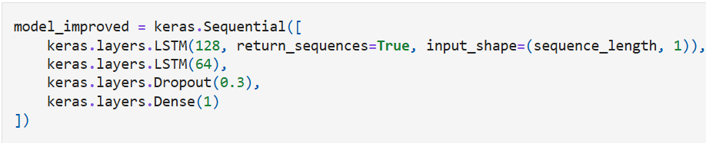

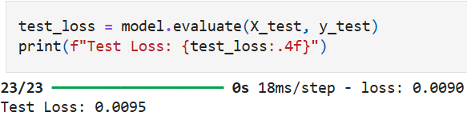
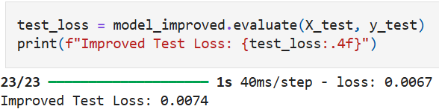
Long Short Term Memory (LSTM)
DATASET : Daily minimum temperature Dataset
AIM : To train and fine tune LSTM to correctly forecast the temperature.
Techniques used – 1. MinMax scaling
2. Dropout
3. Early Stopping
Early Stopping
LSTM
LSTM with dropout and Early stopping

Slide 15
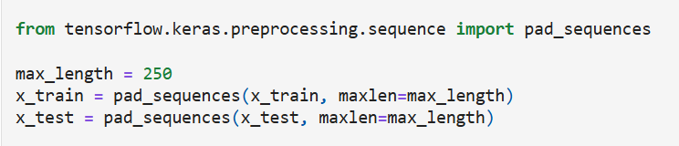
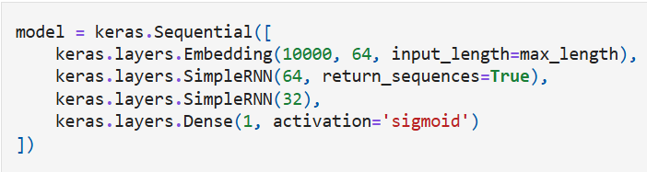
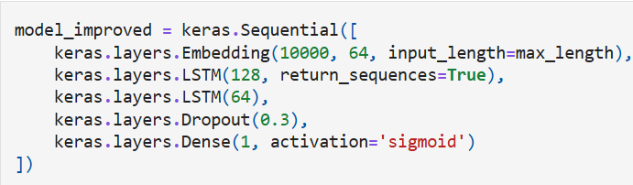
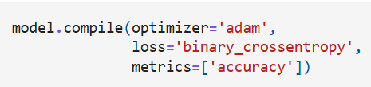
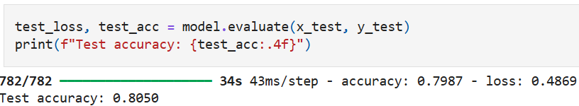
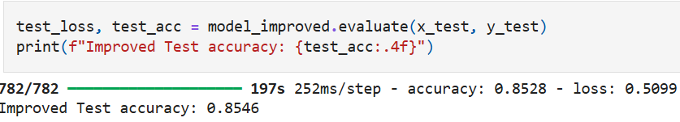
Recurrent Neural Network
DATASET : IMDB Sentiment Analysis Dataset
AIM : To train and fine tune Recurrent Neural network to correctly identify sentiment.
Techniques used – 1. Pad_sequences
2. Dropout
3. MaxPooling2D
Pad_Sequence
Recurrent neural network with SNN layer
RNN with dropout and LSTM layer

Slide 16
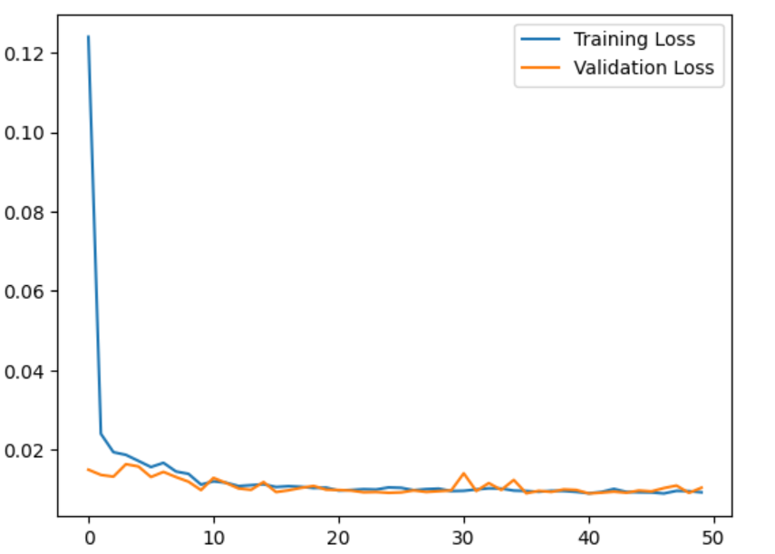
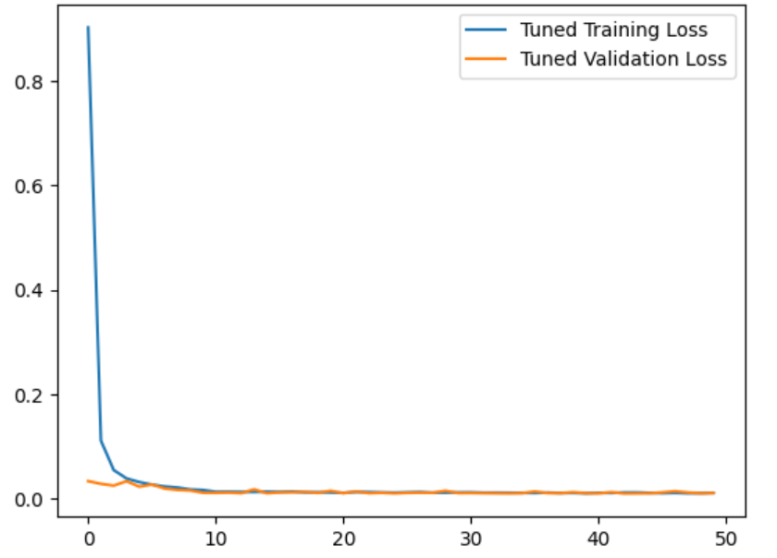
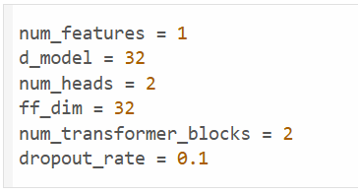
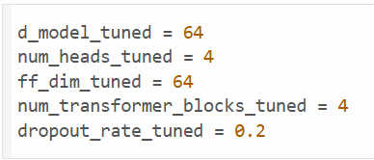




Transformers
DATASET : Daily minimum temperatures Dataset
AIM : To train and fine tune Transformer to correctly forecast temperature.
Techniques used – 1. MinMax Scaling , 2. Reshape, 3. MaxPooling2D.
Transformer Model with parameters
Transformer Model with tuned parameters
Test loss for Tuned Transformer
Test loss for Transformer
MAE for Transformer
MAE for Tuned Transformer

Slide 17


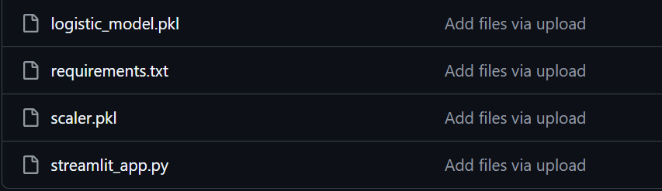


Deployment of Logistic Regression Model
Files used for model deployment
Deployed Model screen
Hugging face space creation

Slide 18


